Slide 1



WHICH FILES OF THE WHY FILES?
OEENDRILA L.GEROLD

Slide 2
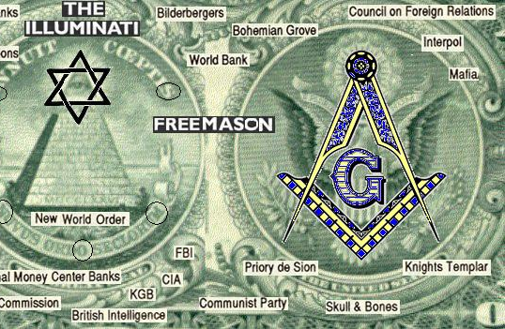
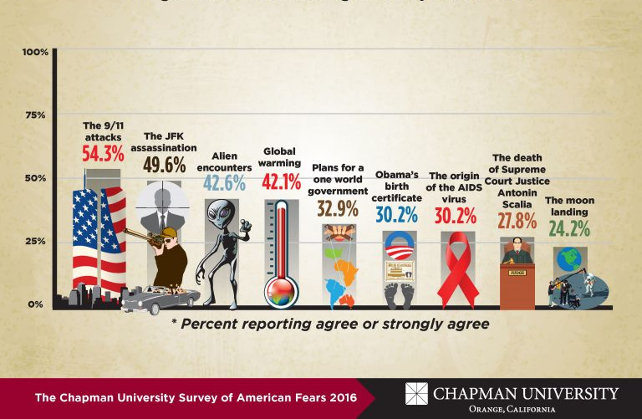
Conspiracy theories + YouTube
CONSPIRACY THEORIES and YOUTUBE
Studies suggest conspiracy theory discussions display key traits of participatory culture
Disinformation as a collective, socially produced phenomenon.
( Ha, Graham, and Gray, 2022, Marwich and Partin, 2022)
Hypothesis: alien/ufo conspiracy videos, closely linked to government conspiracies, would be the highest in engagement based on long-standing observation.
This Photo by Unknown Author is licensed under CC BY-SA-NC
This Photo by Unknown Author is licensed under CC BY
Notes:
My study comes off researching conspiracy theories and disinformation on digital media - and studies suggest that conspiracy theory discussions show traits of participatory culture - That means it shows intense collective sense-making and knowledge production

Slide 3

The why files
The Why Files Description: The Why Files is a channel for people who are fascinated (obsessed) with mysteries, myths, legends and conspiracies. We tell stories, seek the truth, and have a few laughs along the way.
Creator: Andrew Gentiles and Hecklefish Moriarti
Established: 2020
Subscriber Count: 4.17 million
Total Views: 698360472
Total Videos: 273 Topic IDs: /m/01k8wb, /m/098wr
Topic Categories: https://en.wikipedia.org/wiki/Knowledge, https://en.wikipedia.org/wiki/Society
Notes:
THis is a channel i chose based on his popularity - he has a unique way of storytelling - he usually checks the facticity and likes to burst the bubble. so at the end of the video you'll be disappointed that this very fascinating story is actually from some obscure book. but my idea was to just see what gets views and what catches people's interest. As you can see his video is also stacked under knowledge nad society - so that is interesting too.

Slide 4
Data Wrangling & Cleaning
Data disappearing, API-KEY access limit
Concatenating dataframes to adjust for missing data: 273 rows
Usual standardizing
Tags --- > categories ('aliens', 'mystery', 'pol_con', 'mind_control','gene_editing', 'doomsday', 'occult', 'facts', 'space,' 'misc')
The case of missing tags
- turning titles into tags – 115/273 videos
Case of multiple categories
- Creating primary category according to a priority list
Notes:
For api-key had to wait a day and use different keys and then finally started saving data as csv and excel files – this caused a delay cuz the data disappeared
Tags handling required a lot of manual sifting of data and turning them into categories. This I had to do several times because it threw up problems from time to time. lFirst, 115 vieos had missing tags. Second some videos were assigned to multiple categories and this caused a problem when it came to visualising the data as per categories. So I had to go back to make a primary category based on a priority list -

Slide 5
Category | Tags
mind_control | “mind control hypnosis", "mind control", "consciousness", "mind upload", "brain activity"
gene_editing | "dna", "gene editing", "ancient humans", "genetic diversity"
aliens | "alien","martian", "flying saucers", "ufo", "bible", "biblical", "UFO", "ancient technology","alien videos", "extra terrestrials", "alien abduction", "ancient aliens", "Varghina UFO", "ufo videos", "ufo video", "ufo sightings", "ufos", "unidentified flying object"
mystery | "time travel", "future","sergei","saqqara","gosford", "spheres", "mothman","piri", "ark","georgia", "kozyrev", "dorothy", "indrid", "agartha", "worlds","life", "time-slip", "gobekli", "time","lucid dreaming", "underwater ruins", "near death experience","strange sounds", "afterlife", "parallel universe", "philosophers stone", "egypt","spontaneous human combustion","pyramid", "boulders", "betz sphere","michigan dogman", "ghost town","mels hole", "dark watchers","kaspar hauser","coincidences","northern california","atlantis","boobquake","emerald", "creatures", "giants", "mysteries", "reality","dog suicide","aztec culture","voynich code","ancient egypt","bennington triangle","rosalia lombardo","ghost plane","murder mystery", "max headroom hack"]
Political conspiracy (pol_con) | ":["dark web", "project", "roswell", "gateway", "reverse", "hollow", "operation", "cicada", "malta", "patents","illuminati","weird", "moon", "darpa", "moon landing", "artificial intelligence", "conspiracy theories","conspiracies","cia","central intelligence agency", "nikola tesla", "adam and eve story", "pyramid", "simulation", "mysterious sounds”, "freemasonry", "knights templar", "templar's", "jfk", "deepest holes", "simulation theory","russia","apollo", "jejune institute", "surveillance","mount rushmore", "cyberwarfare", "code", "secret space program", "cia declassified", "apollo 11", "Underground City", "nasa","cover-up", "secret", "deepfake", "jfk assassination", "sonic weapon", "area 51"
doomsday | "mass extinction", "apocalypse", "extinction", "end times","psychic","nostradamus"
occult | "horror movies","horror","shadow", "werewolves","exorcism", "exorcisms", "haunted", "lemuria", "superstition","paranormal","ghosts", "ghost hunting", "creepy","creepiest places"
facts | "face mites", "terrifying discovery","weird science", "weird facts", "circleville","farts","strange science","ocean facts","science facts”, "wire", "nanotechnology", "metric system", "what is asmr", "math facts", "asteroid","dinosaur","animal rain","interesting facts"],
space | "solar storm", "strange sounds","panspermia", "kuiper belt", "space", "gravity"
misc | "funny","iphone","pregnant man","james pond", "breeze", "after", "read", "hang-out","thanks", "christmas", "hecklefish", "pajamas", "watch-along", "watch",] }
Category
Priority list: priority_list = 'aliens’> 'mystery’ > 'pol_con’ > 'mind_control’> 'gene_editing’> 'doomsday’> 'occult’> 'facts’> 'space,’ >'misc'
Notes:
So here you can see the categories – I could make this an appendix as well - butif I could I would have made subcategories but I think this was enough. However, there were issues. One of the issue was videos were getting assigned to multiple categories

Slide 6
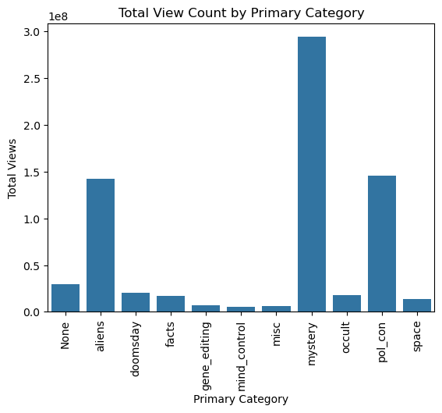
Exploratory Data Analysis ENGAGEMENT DATA AS PER CATEGORY
VIEW COUNT TOTAL:
Mystery: 293794987
Pol conspiracies: 145339799
Aliens: 142380518
Notes:
I’ve done a very simple visualisation here – nothing fancy – that is outside my skillset – of the three engagement metrics – and all three have aliens, political conspiracies, and mystery in them. mysteries are basically urban legends, unresolved phenomena, time travel, folk myths, ancient myths - So people are more interested in urban legends and all

Slide 7
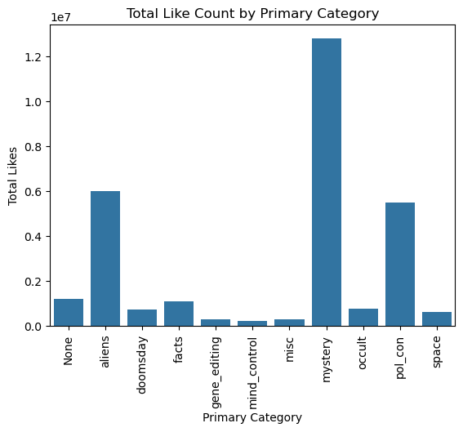
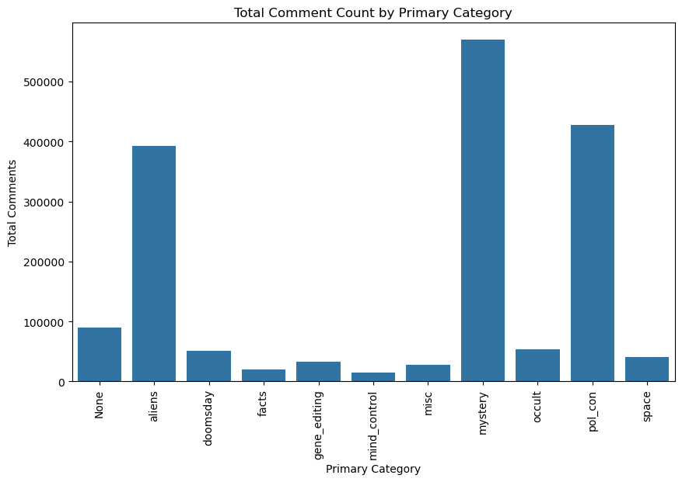
TOTAL LIKE COUNT:
Mystery:12790279
Aliens:6013893
Pol con: 5503269
TOTAL COMMENT COUNT:
Mystery: 569251
Pol con: 426936
Aliens: 392625
Notes:
COMMENT and LIKES– greater engagement here in terms of comments and likes with alien/ufo conspiracies but it is also higher for political conspiracies

Slide 8
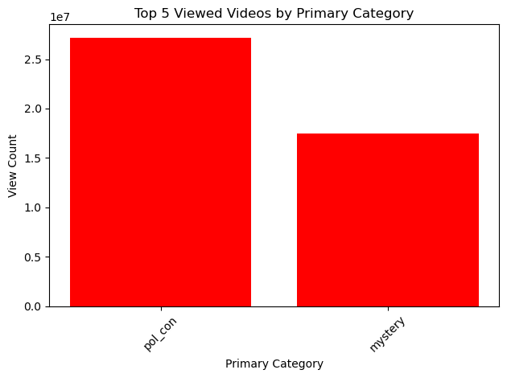
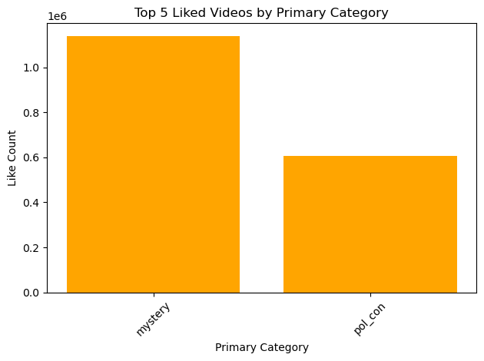
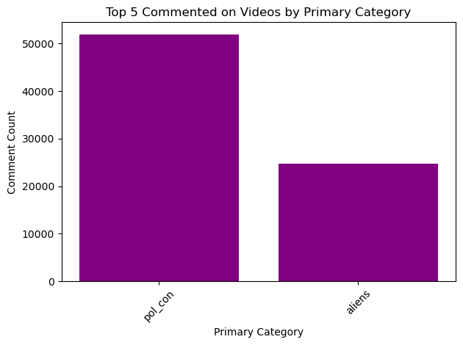

Slide 9

Major Obstacle: Main challenges and lessons learned.
Handling API youtube access and codes to get data in a simpler way
Title split into tags gave back arrays and not list – always check for consistency
Creating subcategories - if I had more time
And visualising the graphs in terms of correlations between engagement trends

Slide 10

Conclusion & Insights
Alien and Ufo conspiracies not the most popular category
Also do views drive type of content or the other way around? Other variables exist
Maybe requires qualitative comment analysis or data analysis tools to understand the interest and higher comment section engagement
People are deeply interested in urban legends (mystery category)
Government scepticism runs through all categories and I need further education to analyse the deeper connections and meaning!
Notes:
Alien and Ufo conspiracies are not most popular category may be peaking when it is in the news but clearly not consistently over time.
He also asks viewers to submit ideas – so it’s not sure how the videos are generated in the first place

Slide 11


Closing Slide: Project name and thank you.

